Slide 1

DevOPS for SCALA
Version 2.0
Cloud Building
for Scala Enthusiasts
Michele Sciabarrà
michele@sciabarra.com

Slide 2

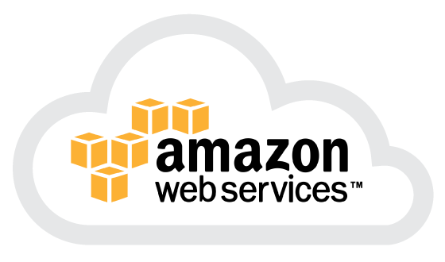
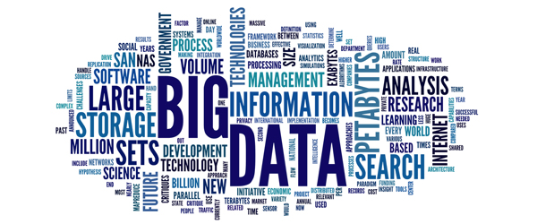
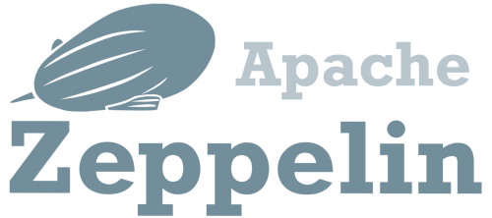

Let's do Big Data in the Cloud

Slide 3



We could do things in the easy way...
Cloudera Distribution
DC/OS
Ambari

Slide 4

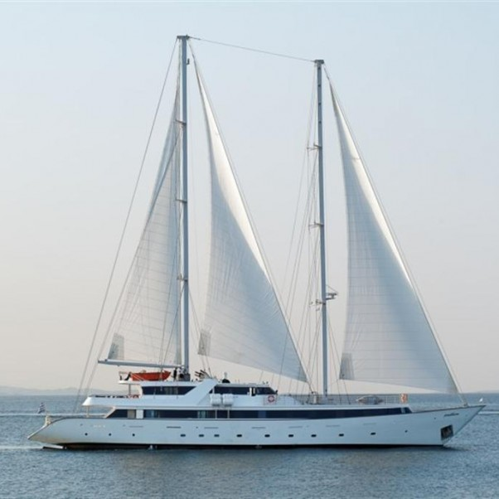
But we like simple things...
What they sell
What you need

Slide 5
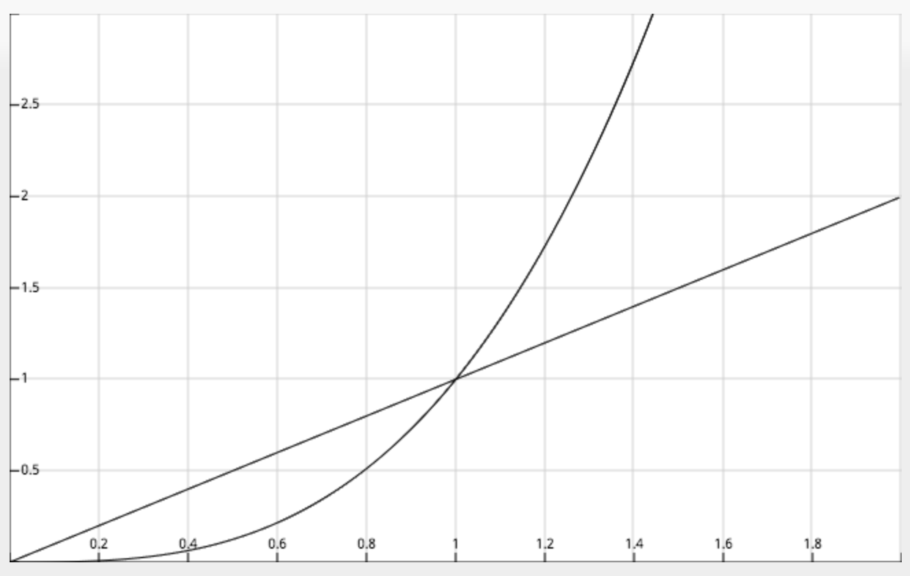
The problem with customisation
Effort
Third Part
Home Grown
Amount of Customisation

Slide 6
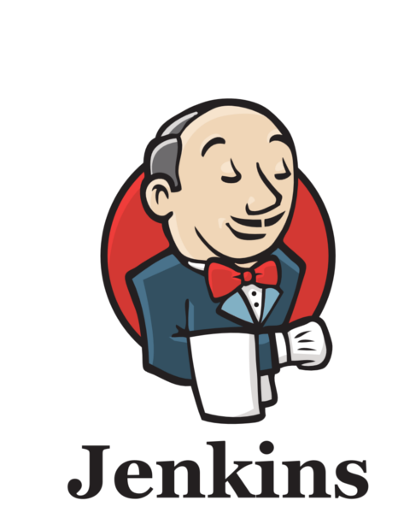

What I want
What I want:
Everything in AWS
Everything in Docker
Everything built with Jenkins
And, of course:
Easy customizability
Easy orchestration
Cheapest solution in the cloud

Slide 7
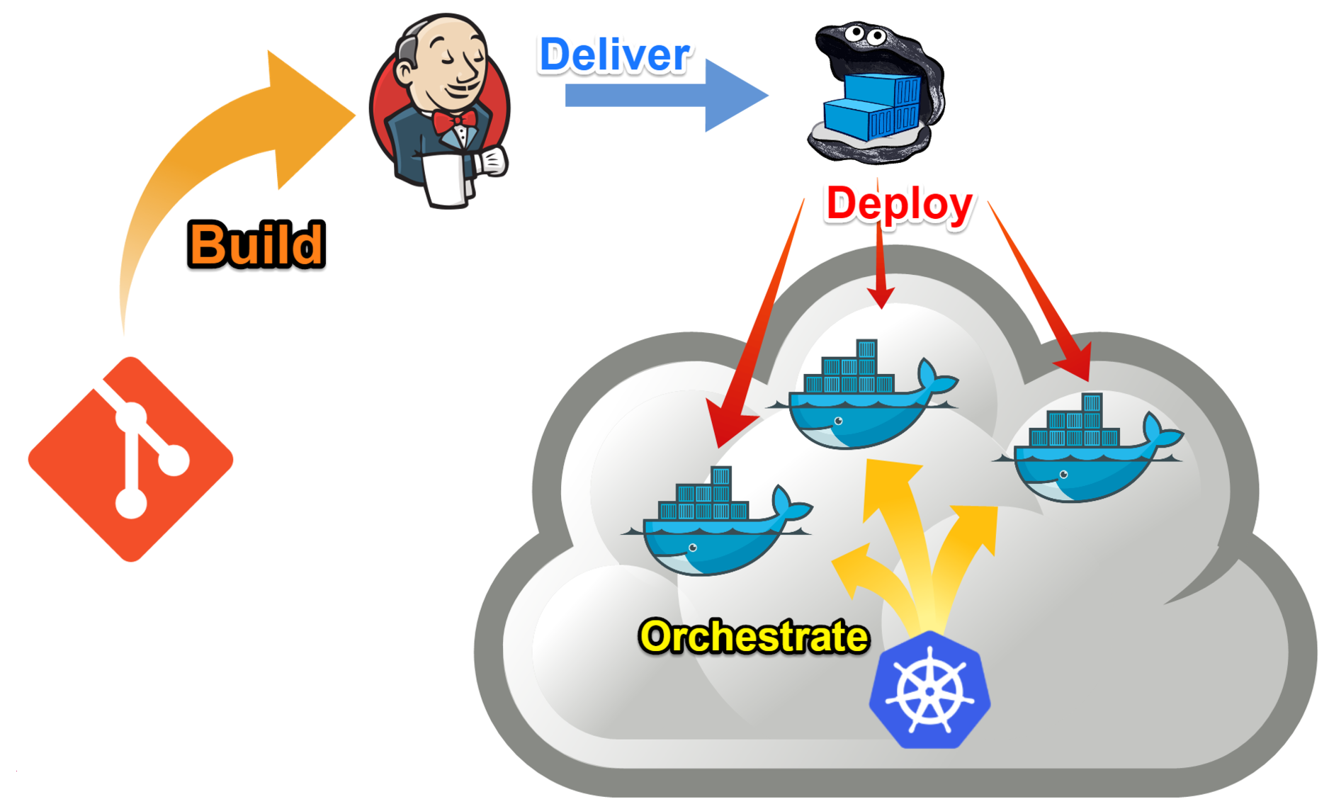
Mission Statement

Slide 8


What I do NOT want
What I DO NOT want:
Hadoop
(even if I like it)
Unused components eating precious memory in the cloud
Be stuck to one version of a component

Slide 9
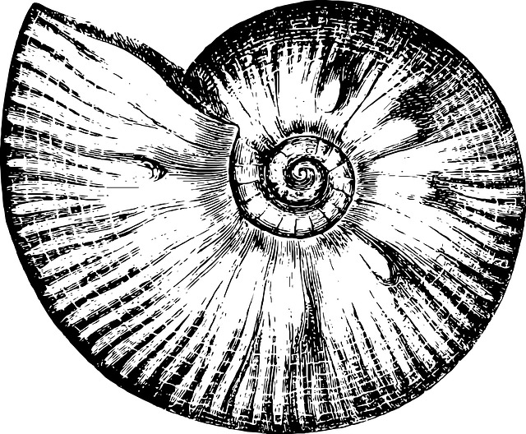
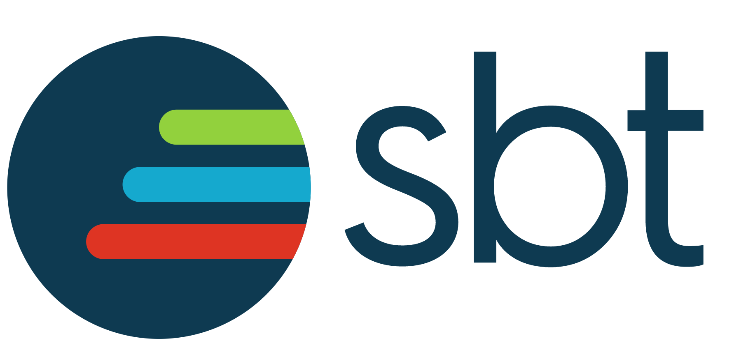
Introducing Mosaico 2
http://github.com
/sciabarracom/Mosaico2
It is not a distribution!
It is not a framework!
Open Source
It is a "starter kit" for
creating a cloud in AWS with Terraform
Installing Docker and Docker Swarm with Ansible
Building Images with Jenkins and SBT
Orchestrating services with Docker Compose
Ammonite
Warning: documentation is sparse!

Slide 10
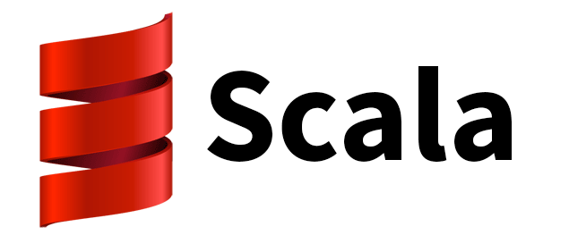
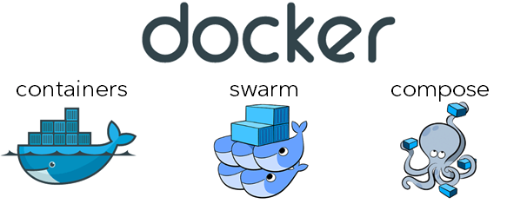
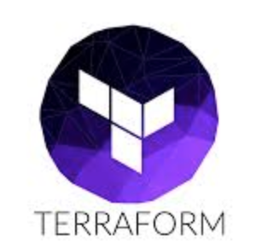
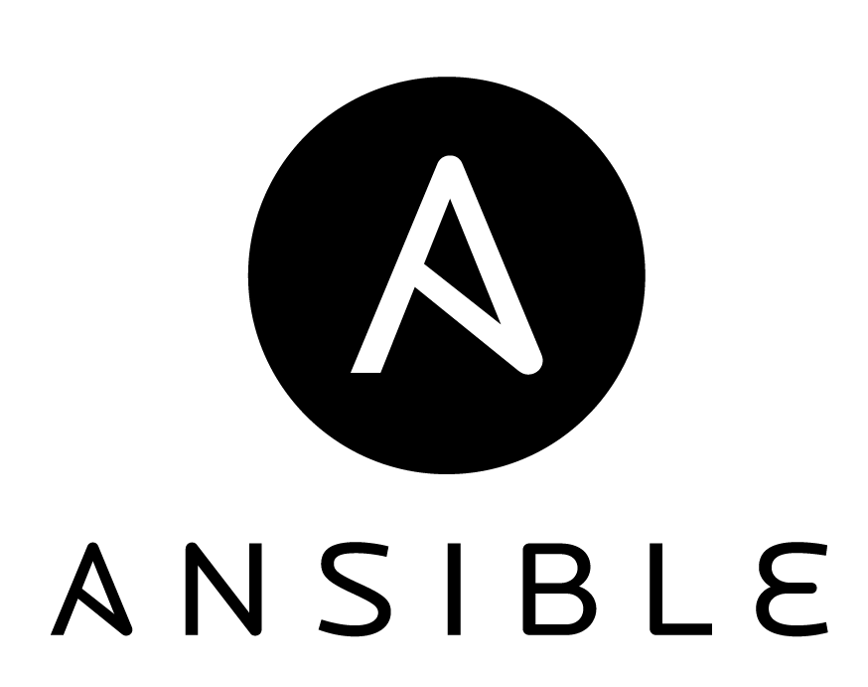
Building on the shoulders of giants
Ammonite

Slide 11

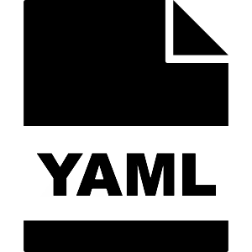
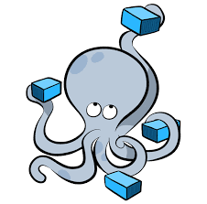
The real life of a DevOps
HCL

Slide 12


How I feel when I script with
BASH
SCALA

Slide 13



Bonus slide: Other feelings
PERL
PYTHON
RUBY

Slide 14
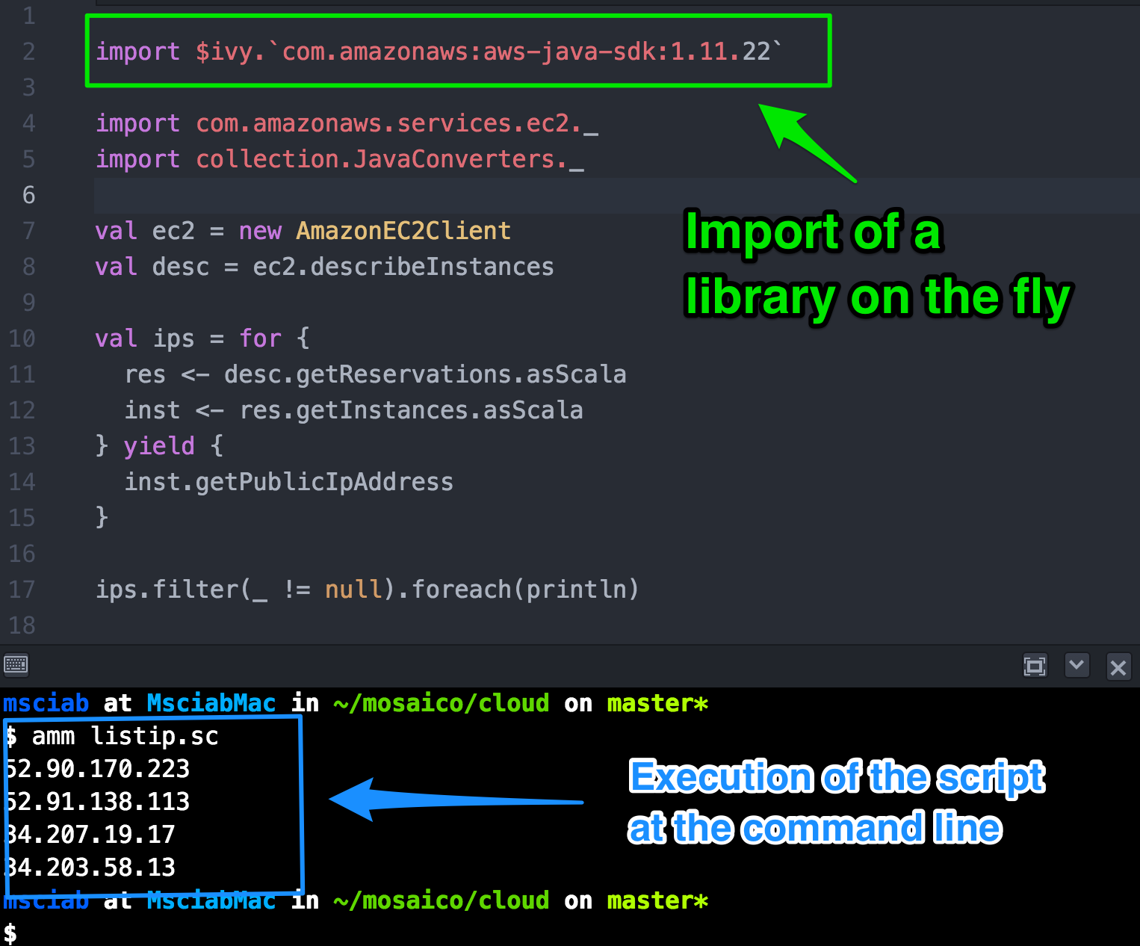

Introducing
Ammonite
by Li Haoyi
Used as
REPL in
Dotty
(Scala 3.0)

Slide 15
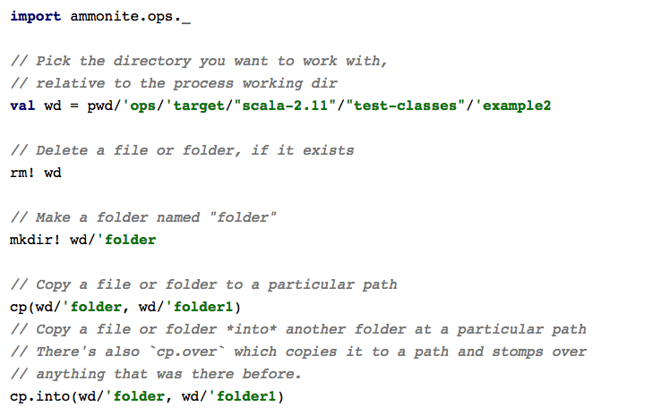
Ammonite Scripting features

Slide 16
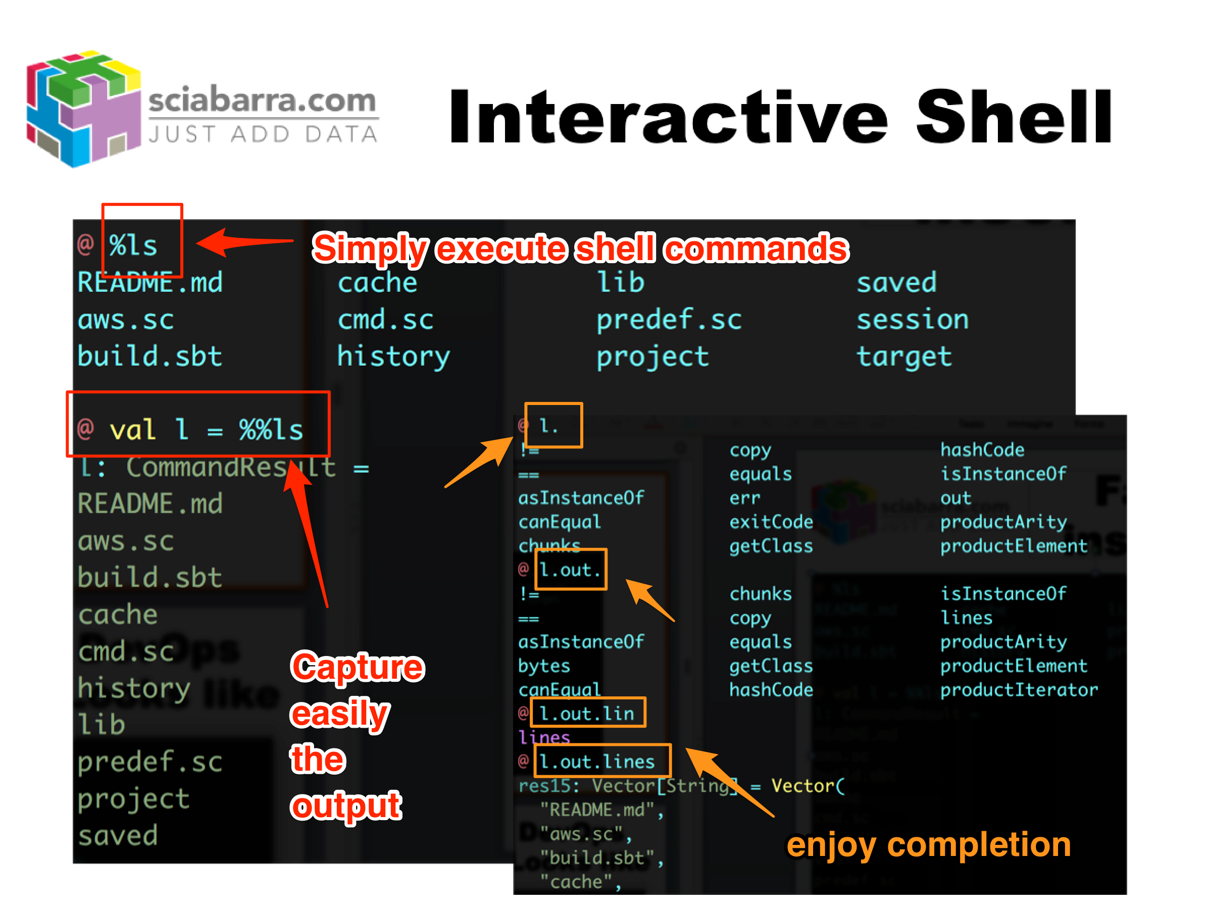
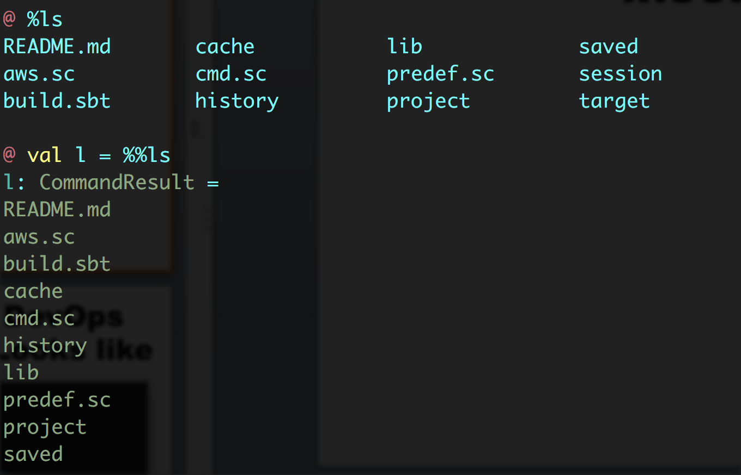
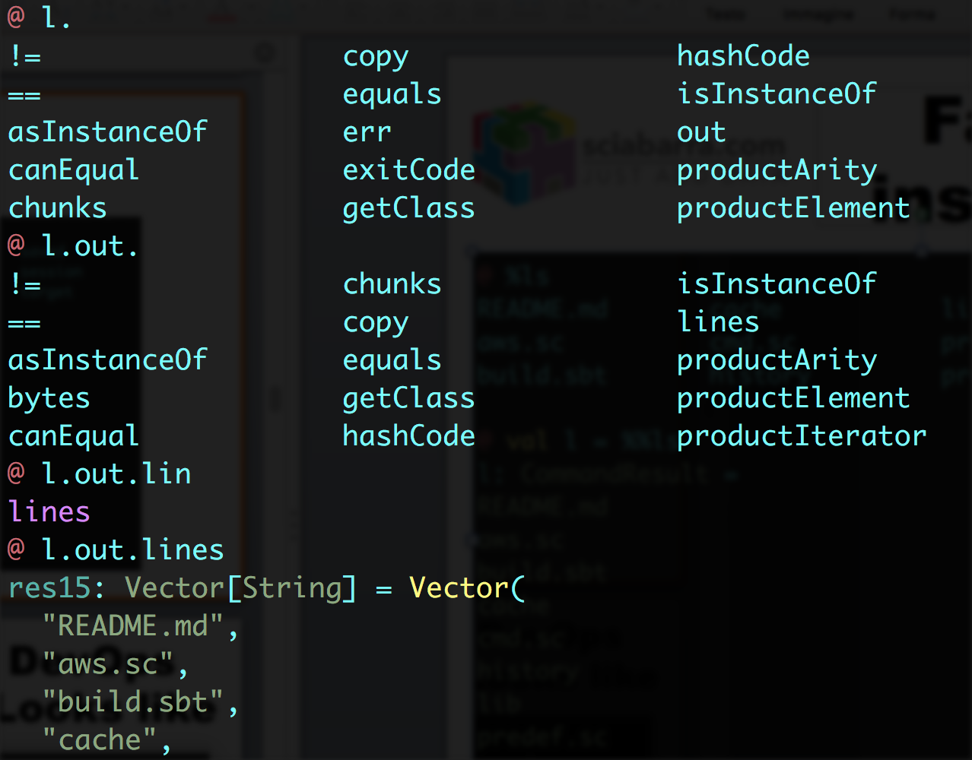
Interactive Shell

Slide 17
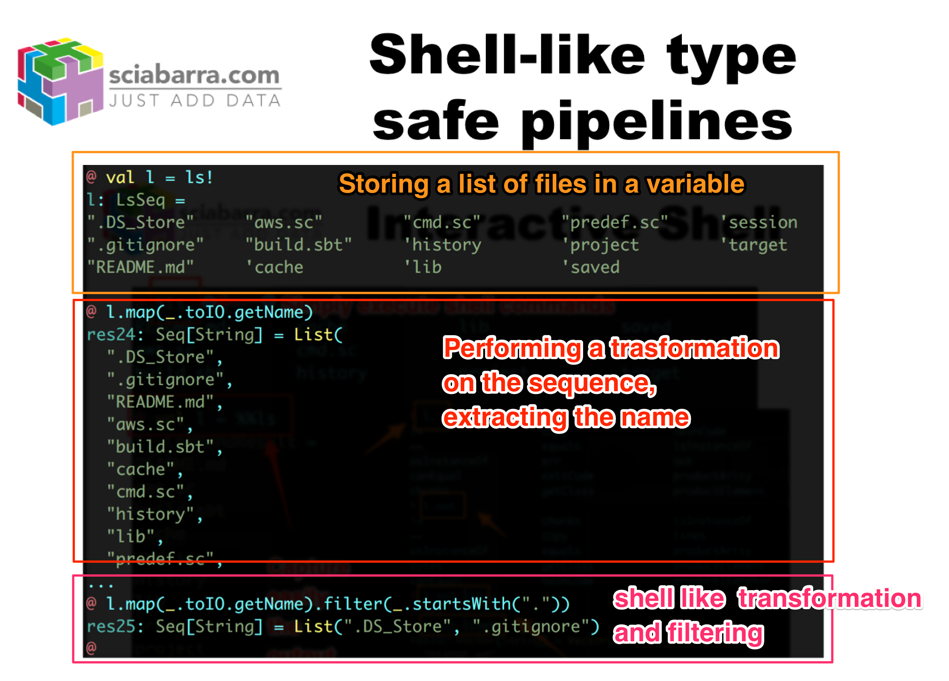
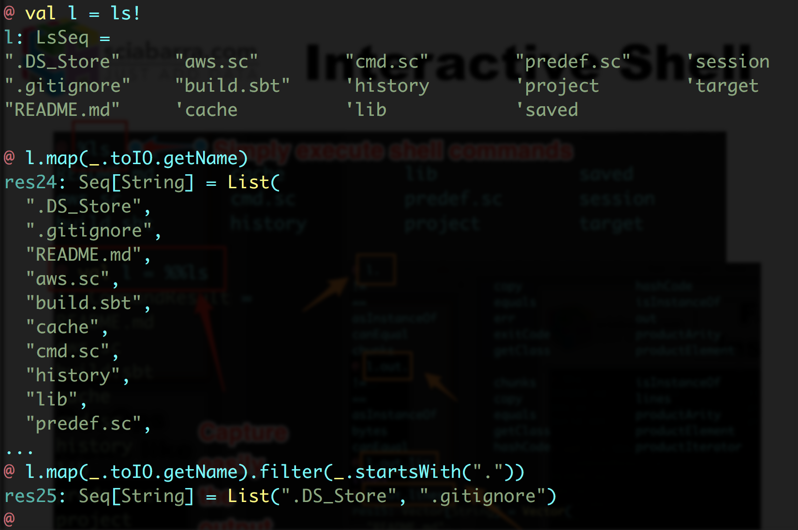
Shell-like type safe pipelines

Slide 18
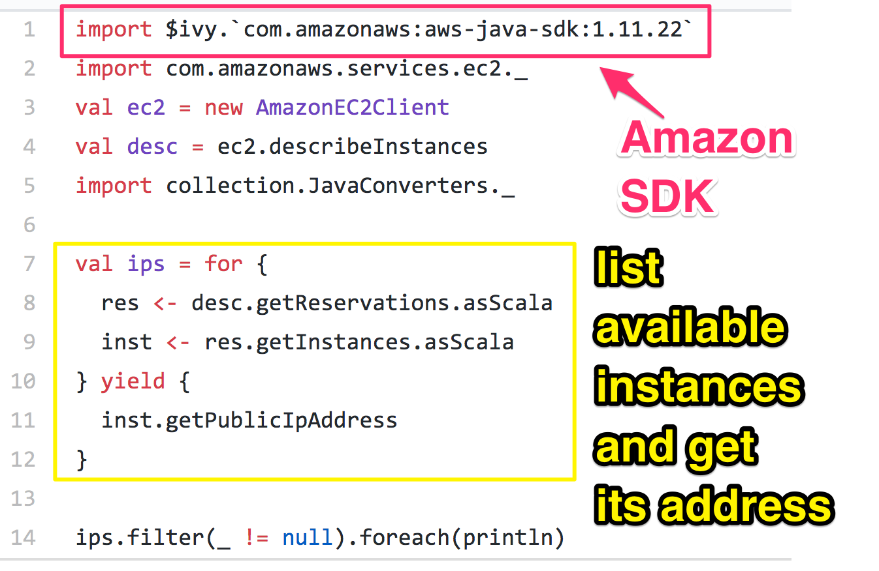
Easy Access to Cloud Libraries

Slide 19
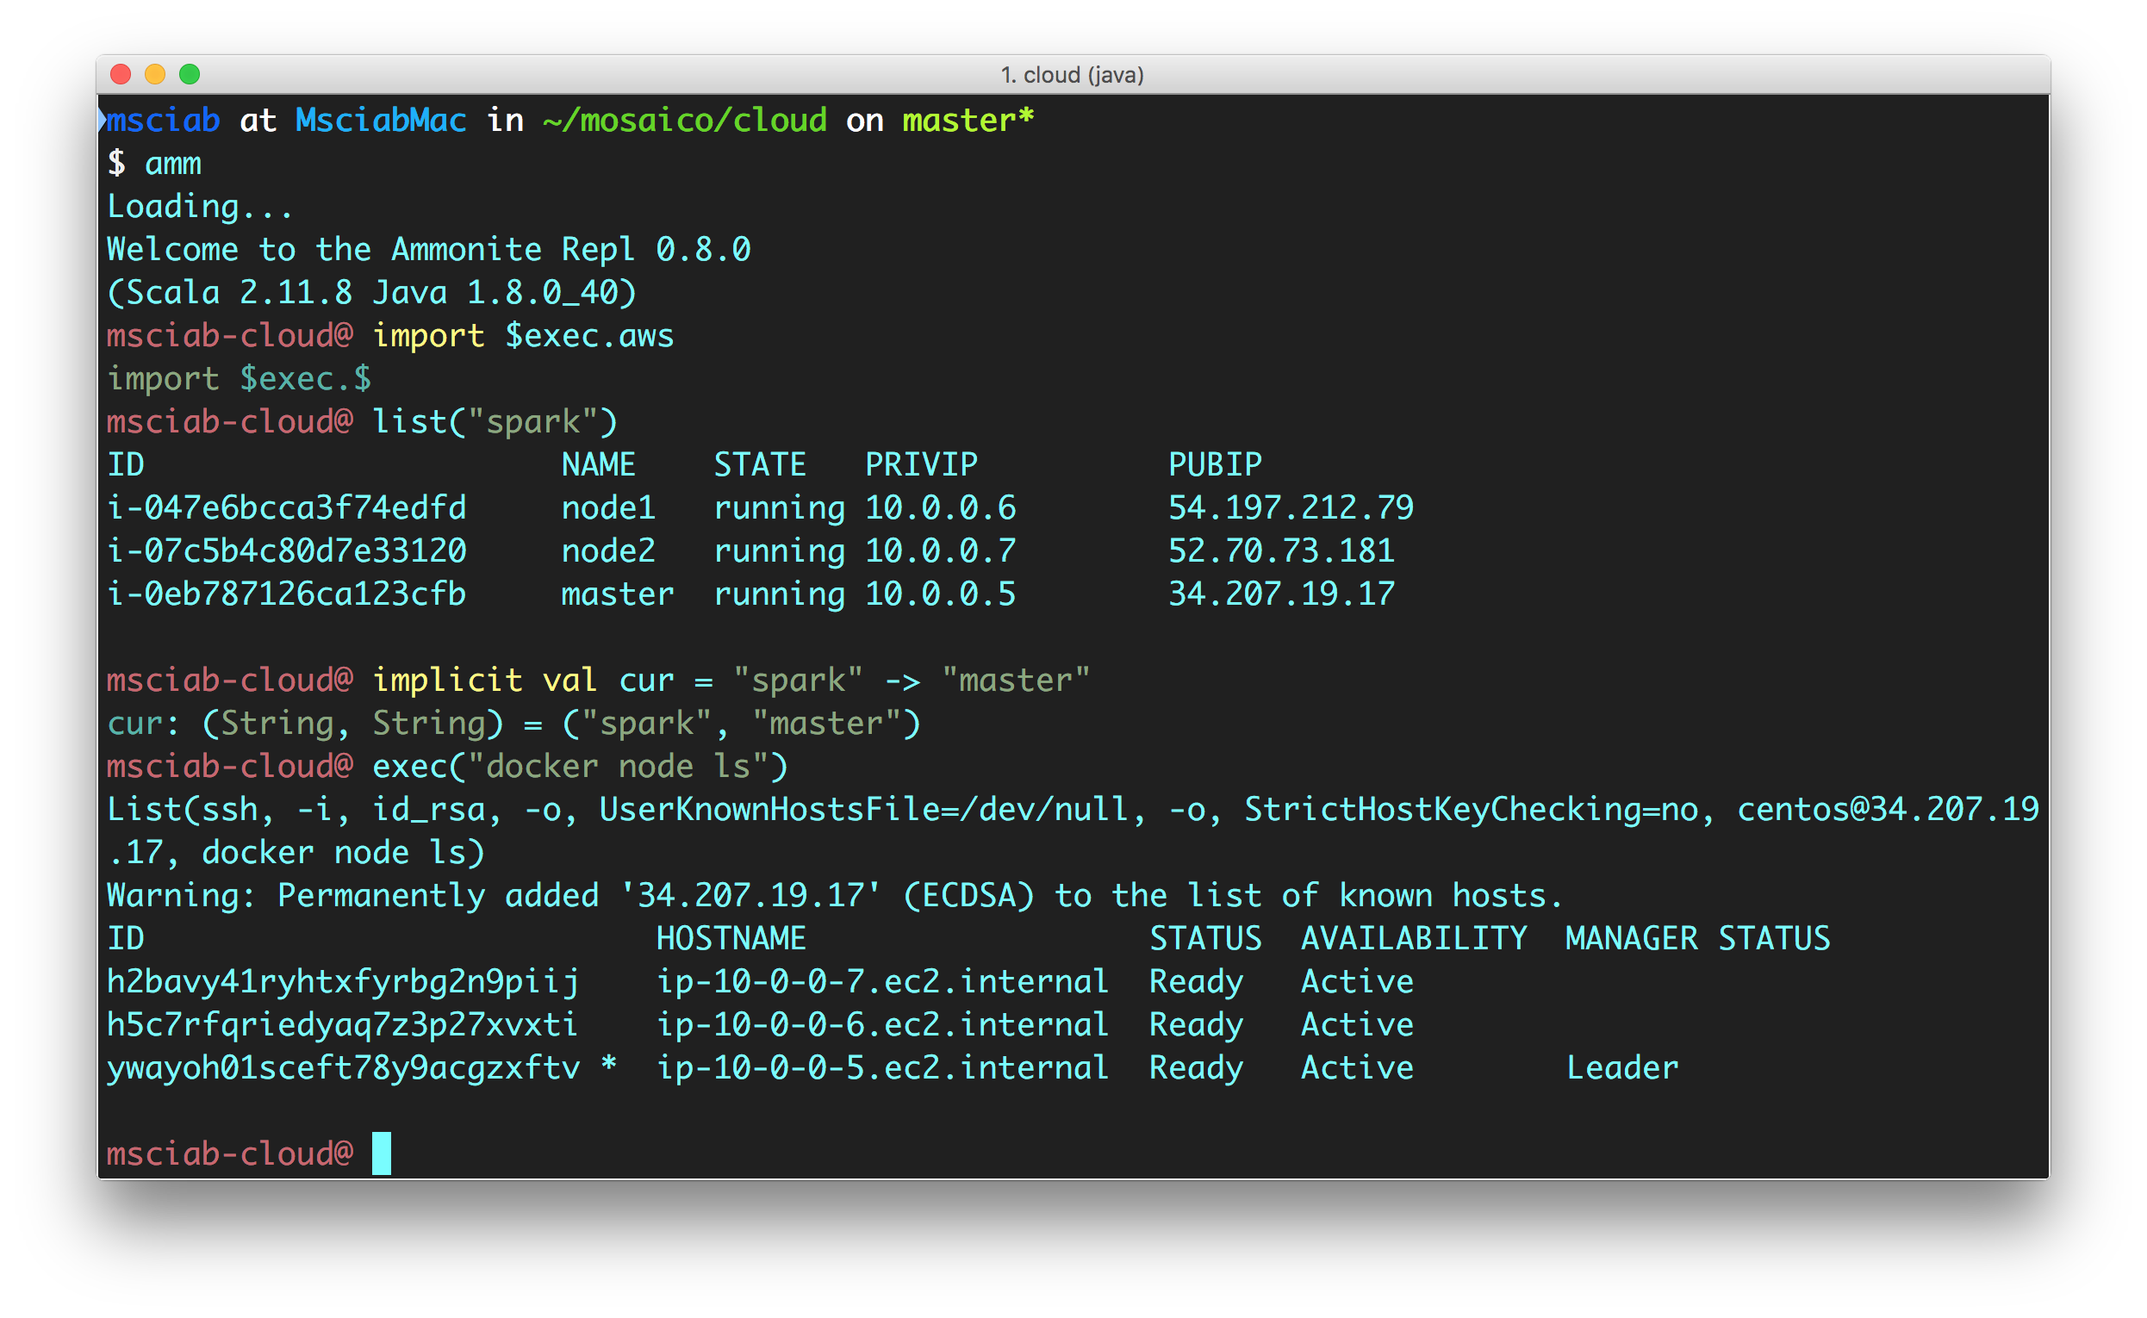
How a DevOps DevEnv Looks like

Slide 20
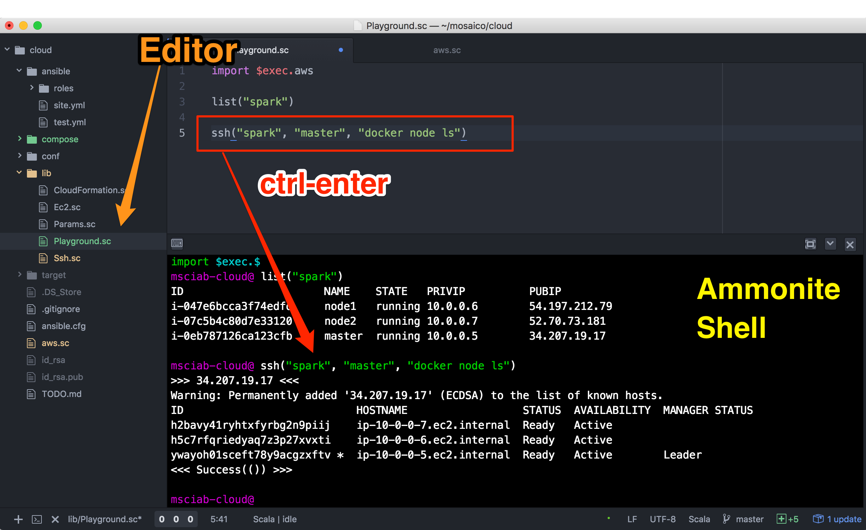
Developing with ease

Slide 21

Ammonite within Atom

Slide 22
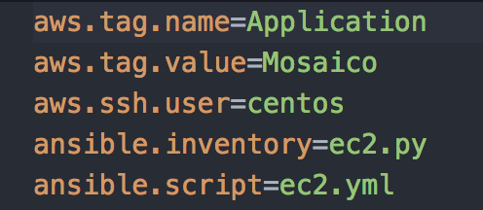
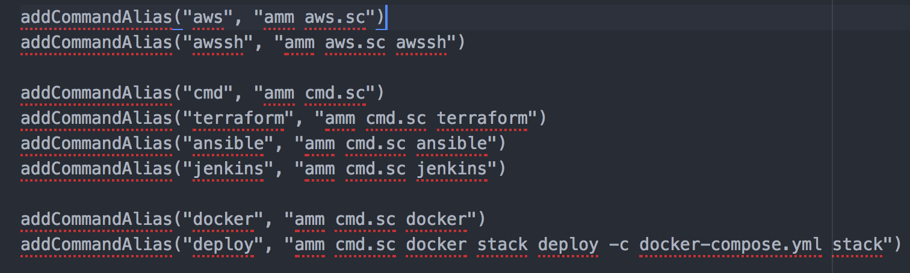
Ammonite & SBT
SBT provides
launch
command line
configuration
macros

Slide 23
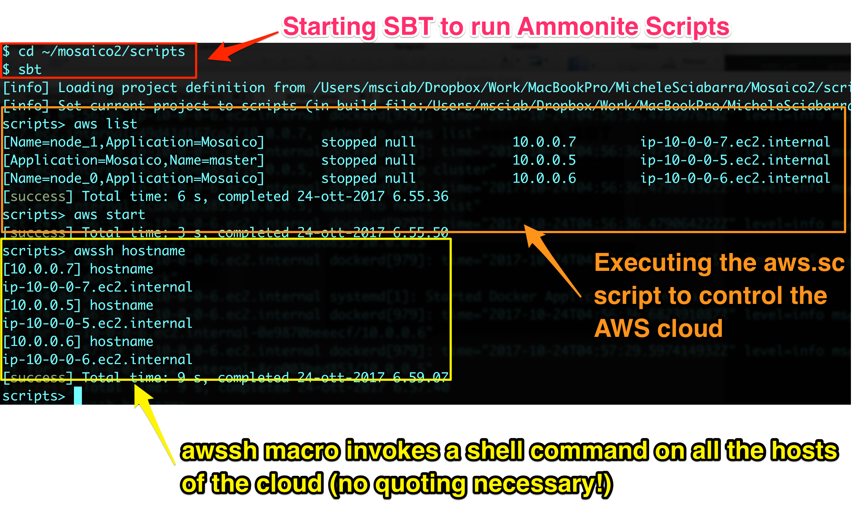
Ammonite-in-SBT in action

Slide 24
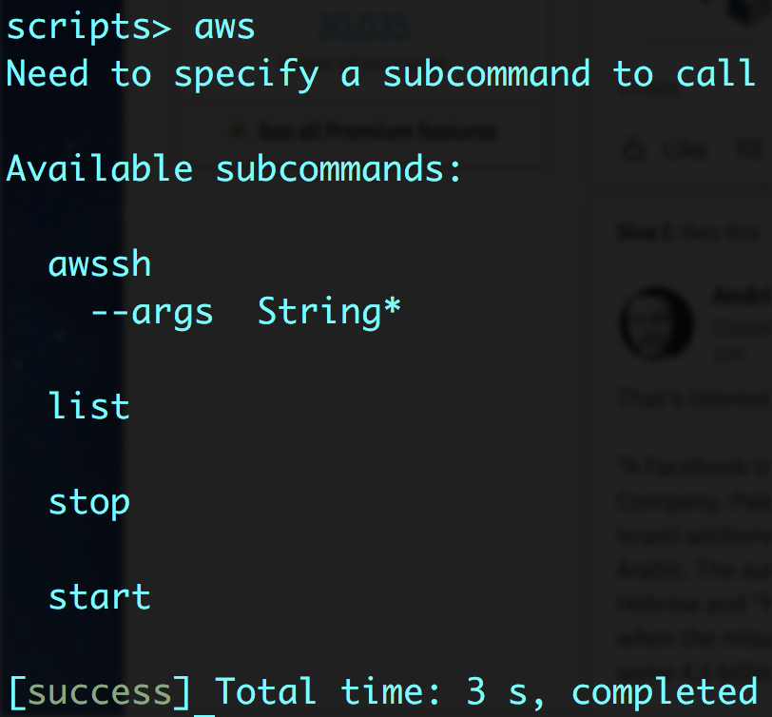
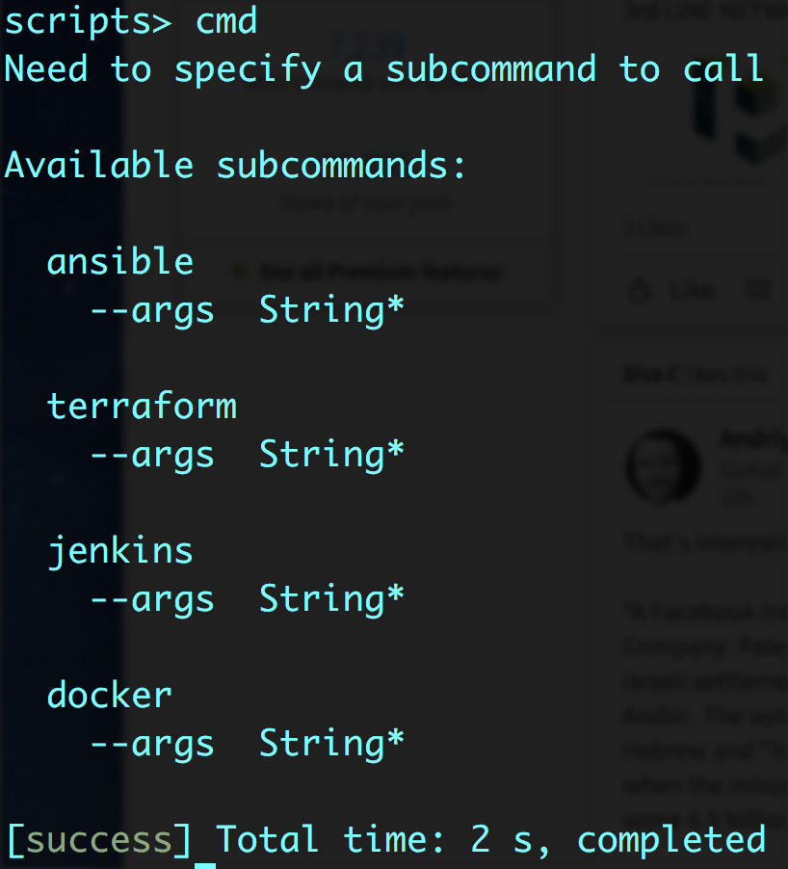
Two Ammonite scripts to rule it all

Slide 25
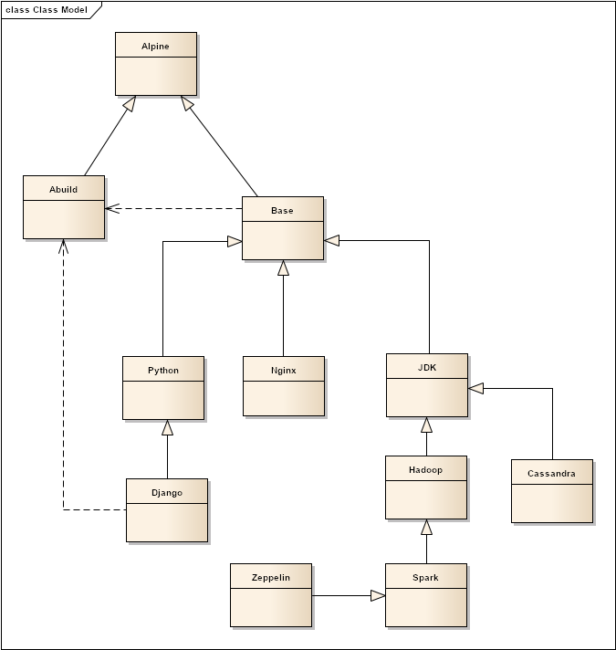
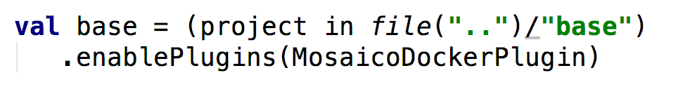
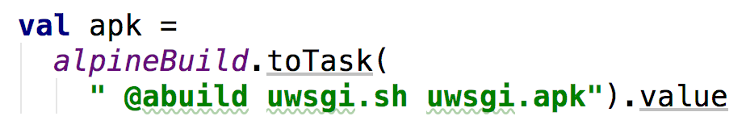
Building Images with SBT

Slide 26
What is wrong about Dockerfile?
Why do I need SBT to build images?
No preprocessing available
download
move files around
No dependencies between containers
No builds using other containers
No configuration files
No profiles

Slide 27
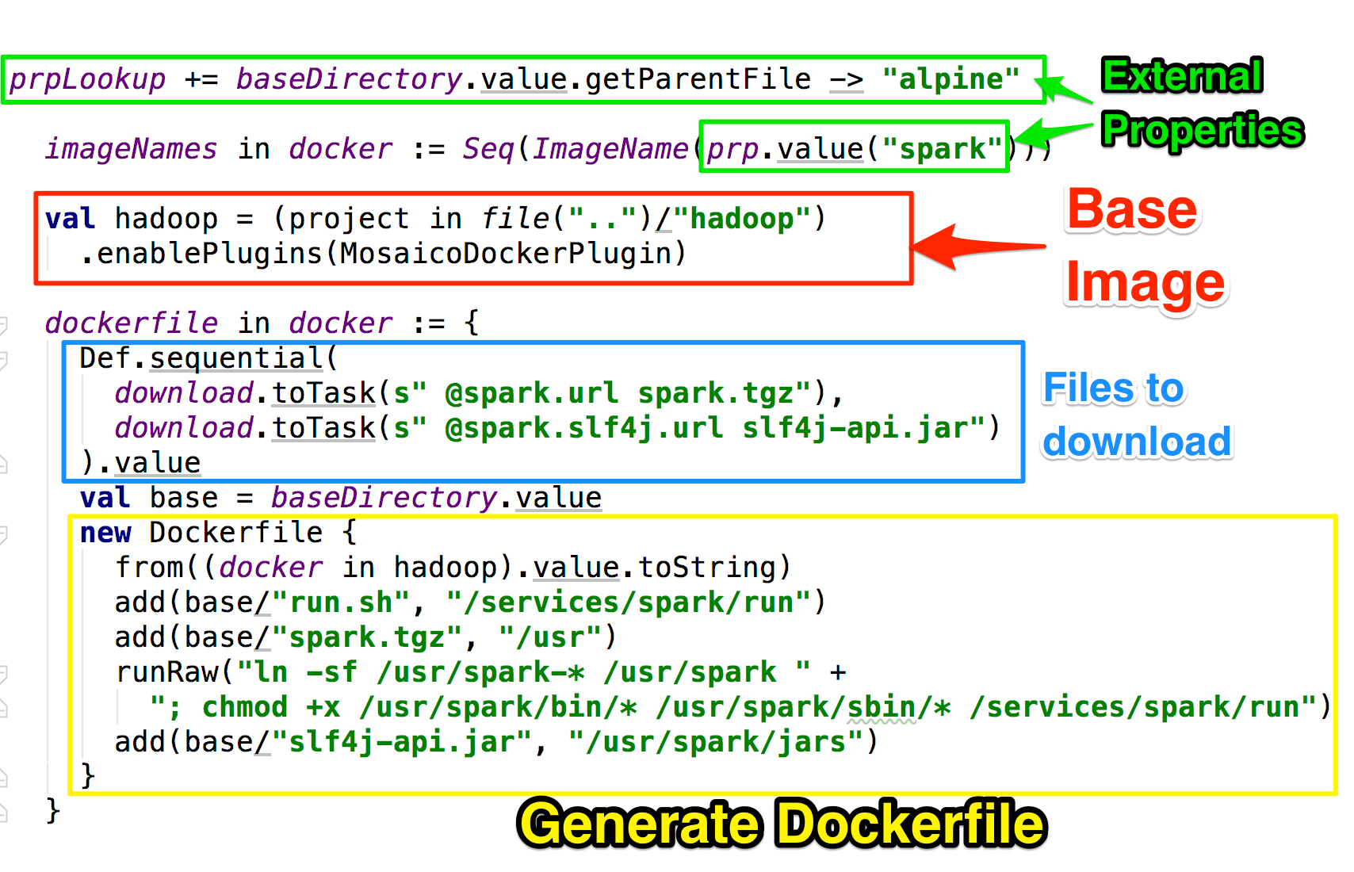
Building with SBT-DOCKER

Slide 28
MosaicoDocker SBT Plugin
Extends SBT-DOCKER
Model dependencies between containers
Can script Dockerfile generation in scala
External configuration files
Downloading of files before building the image
Ability to compile and build packages using other images
Smart "unpacking" of archives (removing unnecessary files)

Slide 29

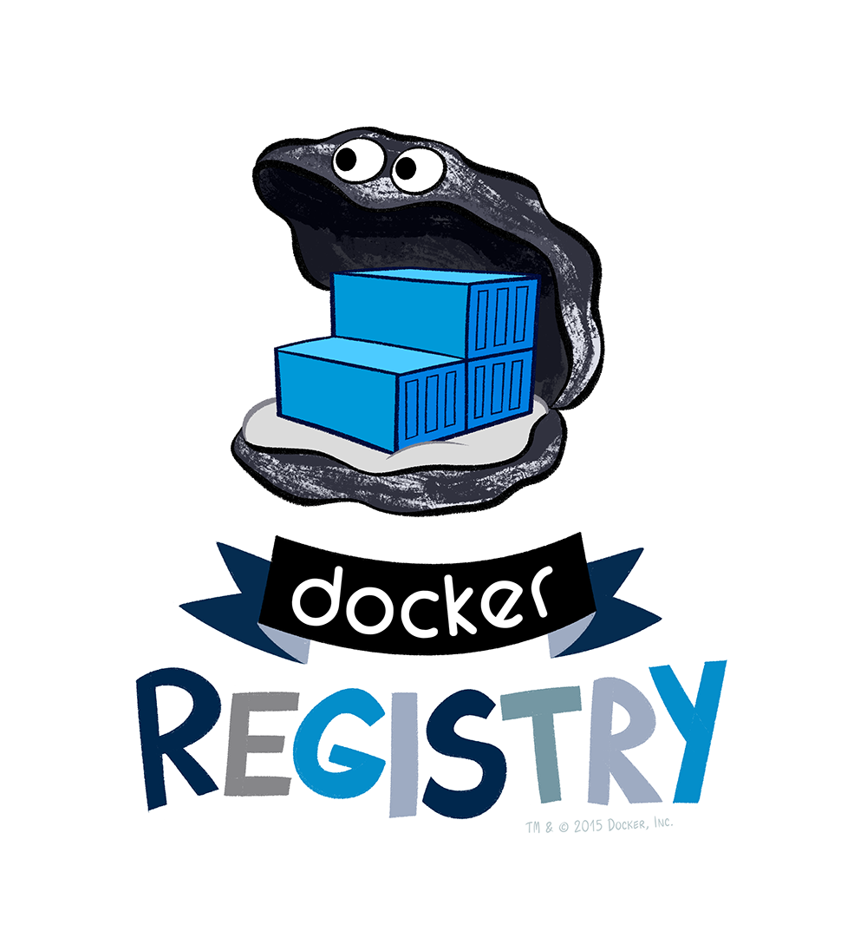

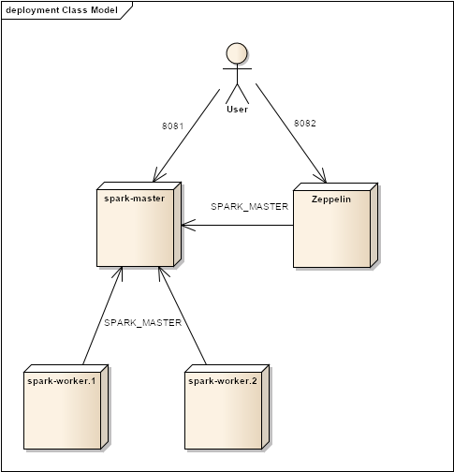
Four Steps to the Enlightment
1
2
terraform
ansible
3
4
jenkins
deploy

Slide 30
Step 1: building the cloud
Ammonite
Actually: creating the VMs....

Slide 31
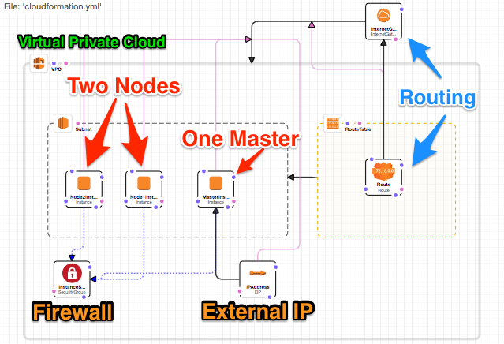
The Cloud

Slide 32
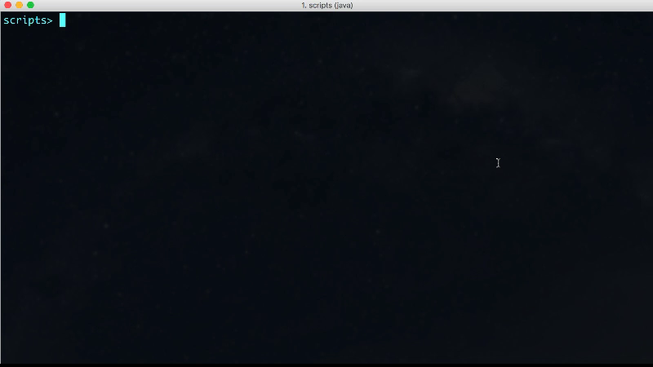
Terraform in Action

Slide 33
Step 2 Deploying Docker Swarm
Ammonite

Slide 34
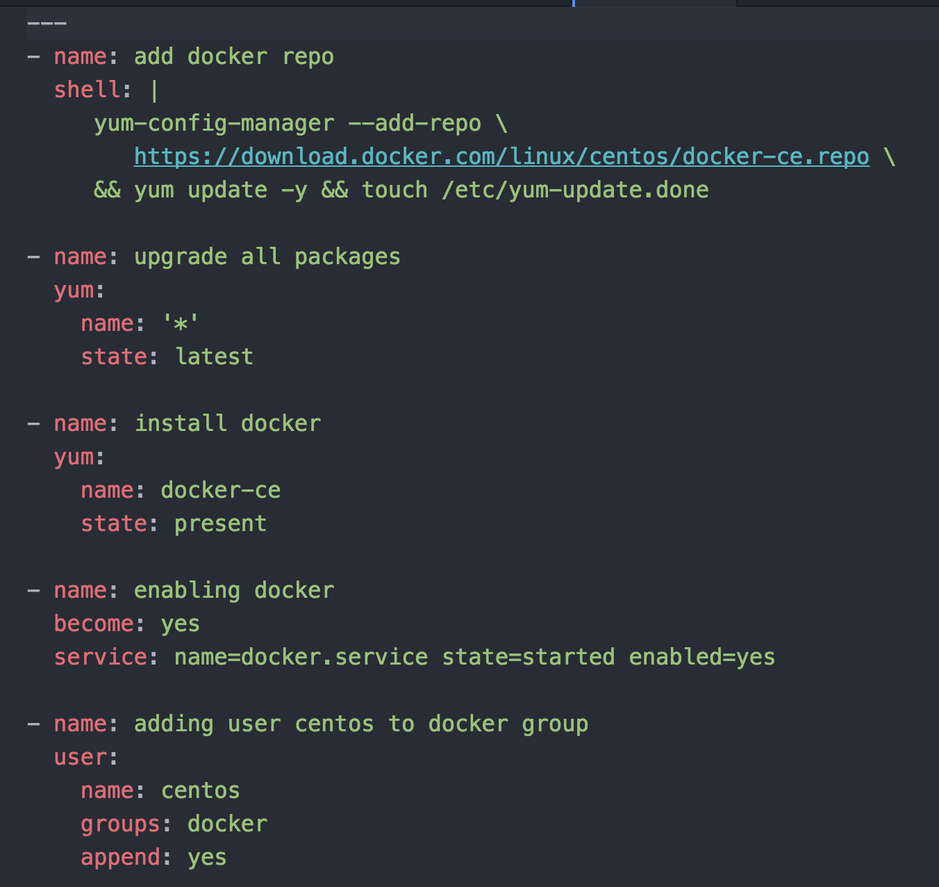
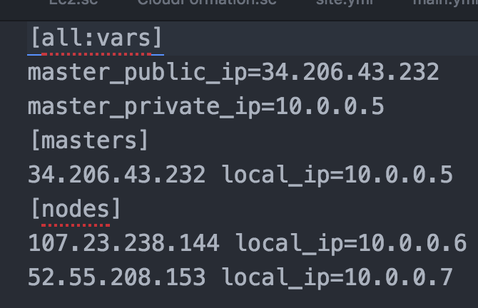
How ansible looks like
A collection of tasks
An inventory file

Slide 35
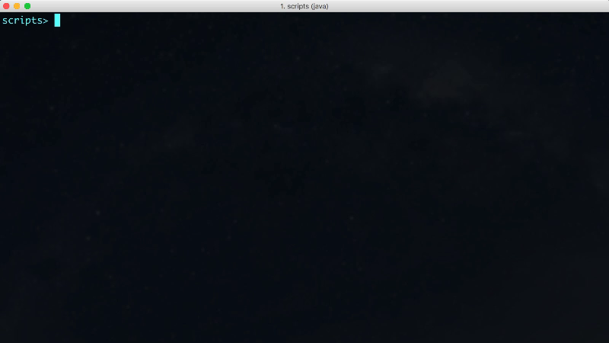
Deploy the Swarm with Ansible

Slide 36
Step 3. Building Docker Images

Slide 37
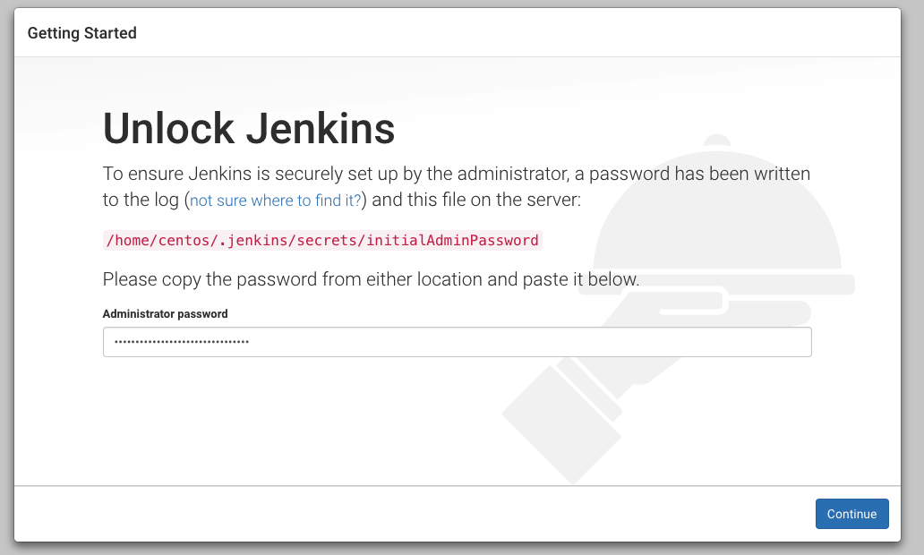
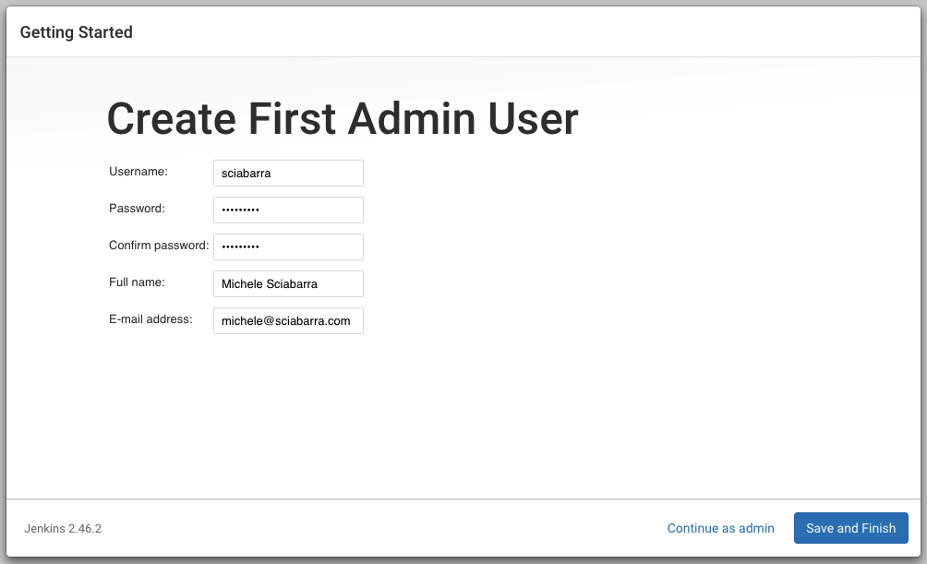
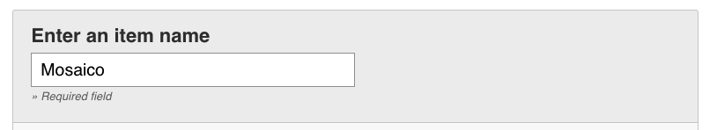
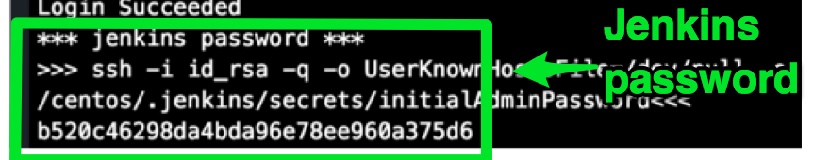
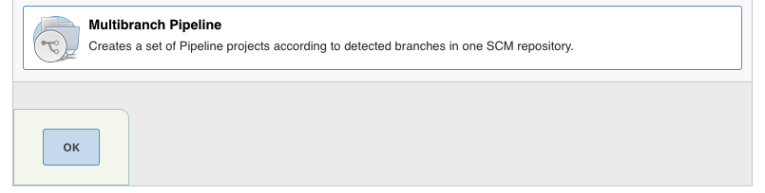
Preparing Jenkins
1
2
3

Slide 38
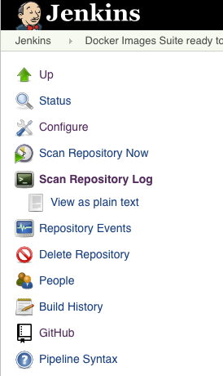
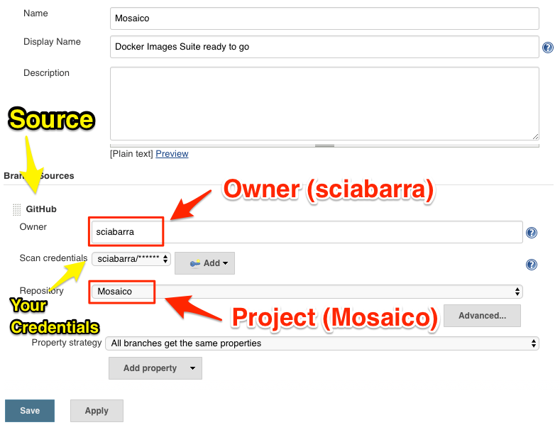
Create a Jenkins Job to build
4

Slide 39
Building Images with Jenkins

Slide 40
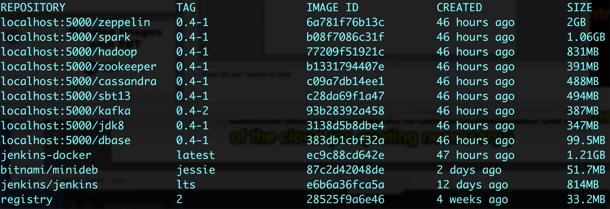
Final Result
with SBT and Jenkins

Slide 41
Step 4 Orchestrate
Ammonite
Docker Compose

Slide 42
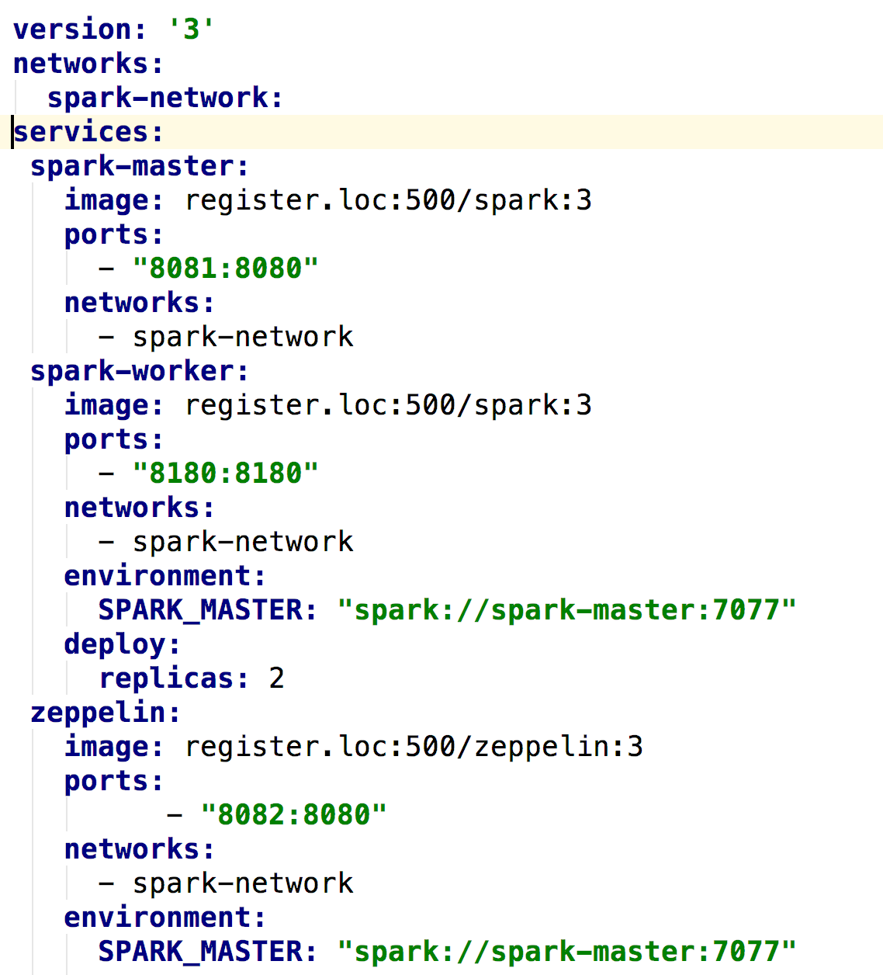
Orchestrate

Slide 43
Orchestration

Slide 44

Thank You!

